Slide 1
digital image processing oec19034 cartoonizing an input image
p.s.Athista Vignesh - 191001013
k.Bharath kumar - 191001015

Slide 2
Abstract
This project represents different techniques of converting image to cartoon. Using any one of below mentioned techniques it is possible to convert all types of captured images to cartoon such as images of person, mountains, trees, flora and fauna etc. There are several other techniques for image to cartoon conversion such as using photoshop, adobe illustrator, windows MAC, paint.net and much more.

Slide 3
introduction
With the recent success of Instagram, the popularity of simple and fun photo effects apps has been on the rise. The computer platform presents a unique arena for these applications by connecting users with both the means to capture images, and the computational power to perform sophisticated processing on these images. Tonify seeks to leverage the existing OpenCV library in order to emulate a particular effect known as Bilateral Effect in the computer graphics world.

Slide 4
Algorithm :
Application of blur – gauss,median,bilateral
Application of Laplacian
Application of grayscale
Application of noise
Application of threshold
Inversing color
Reducing color of original – kmeans or binary divide
merging

Slide 5
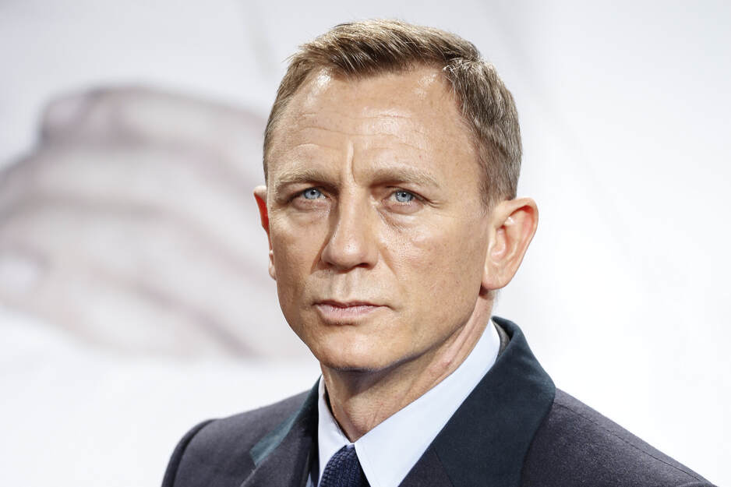
Input image

Slide 6
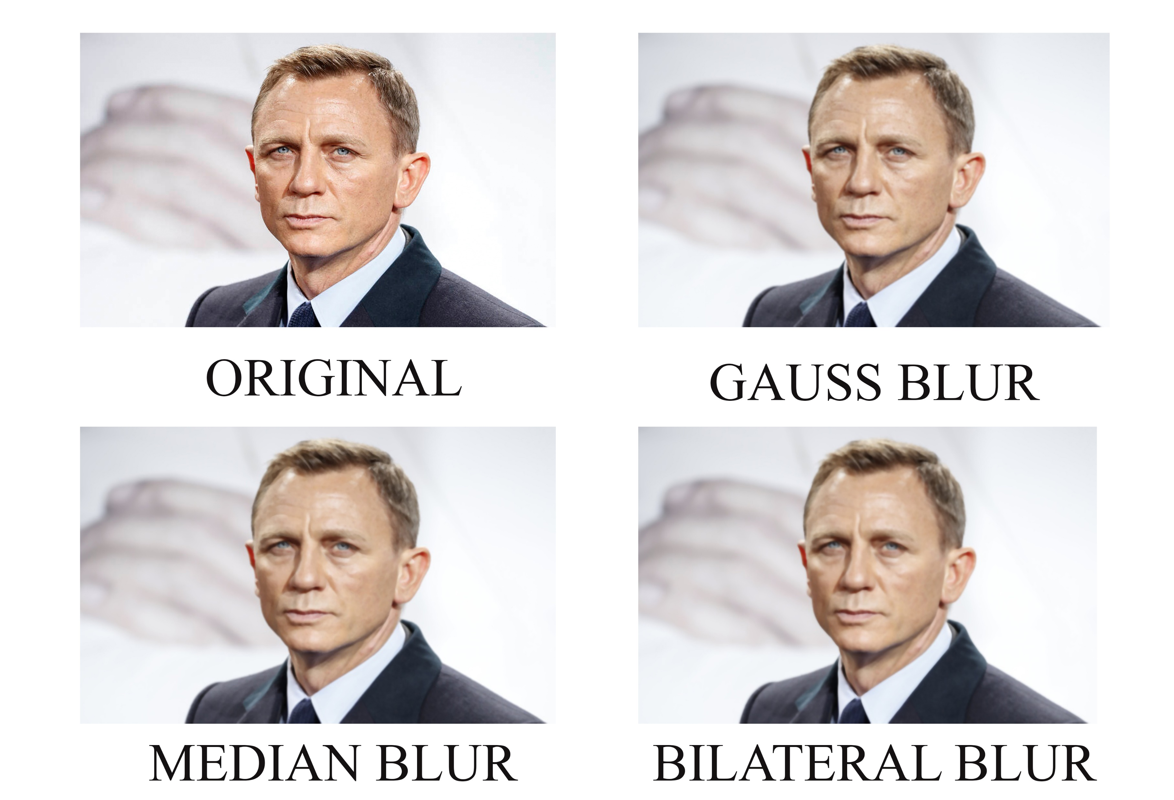
Application of blur –gauss,median,bilateral

Slide 7
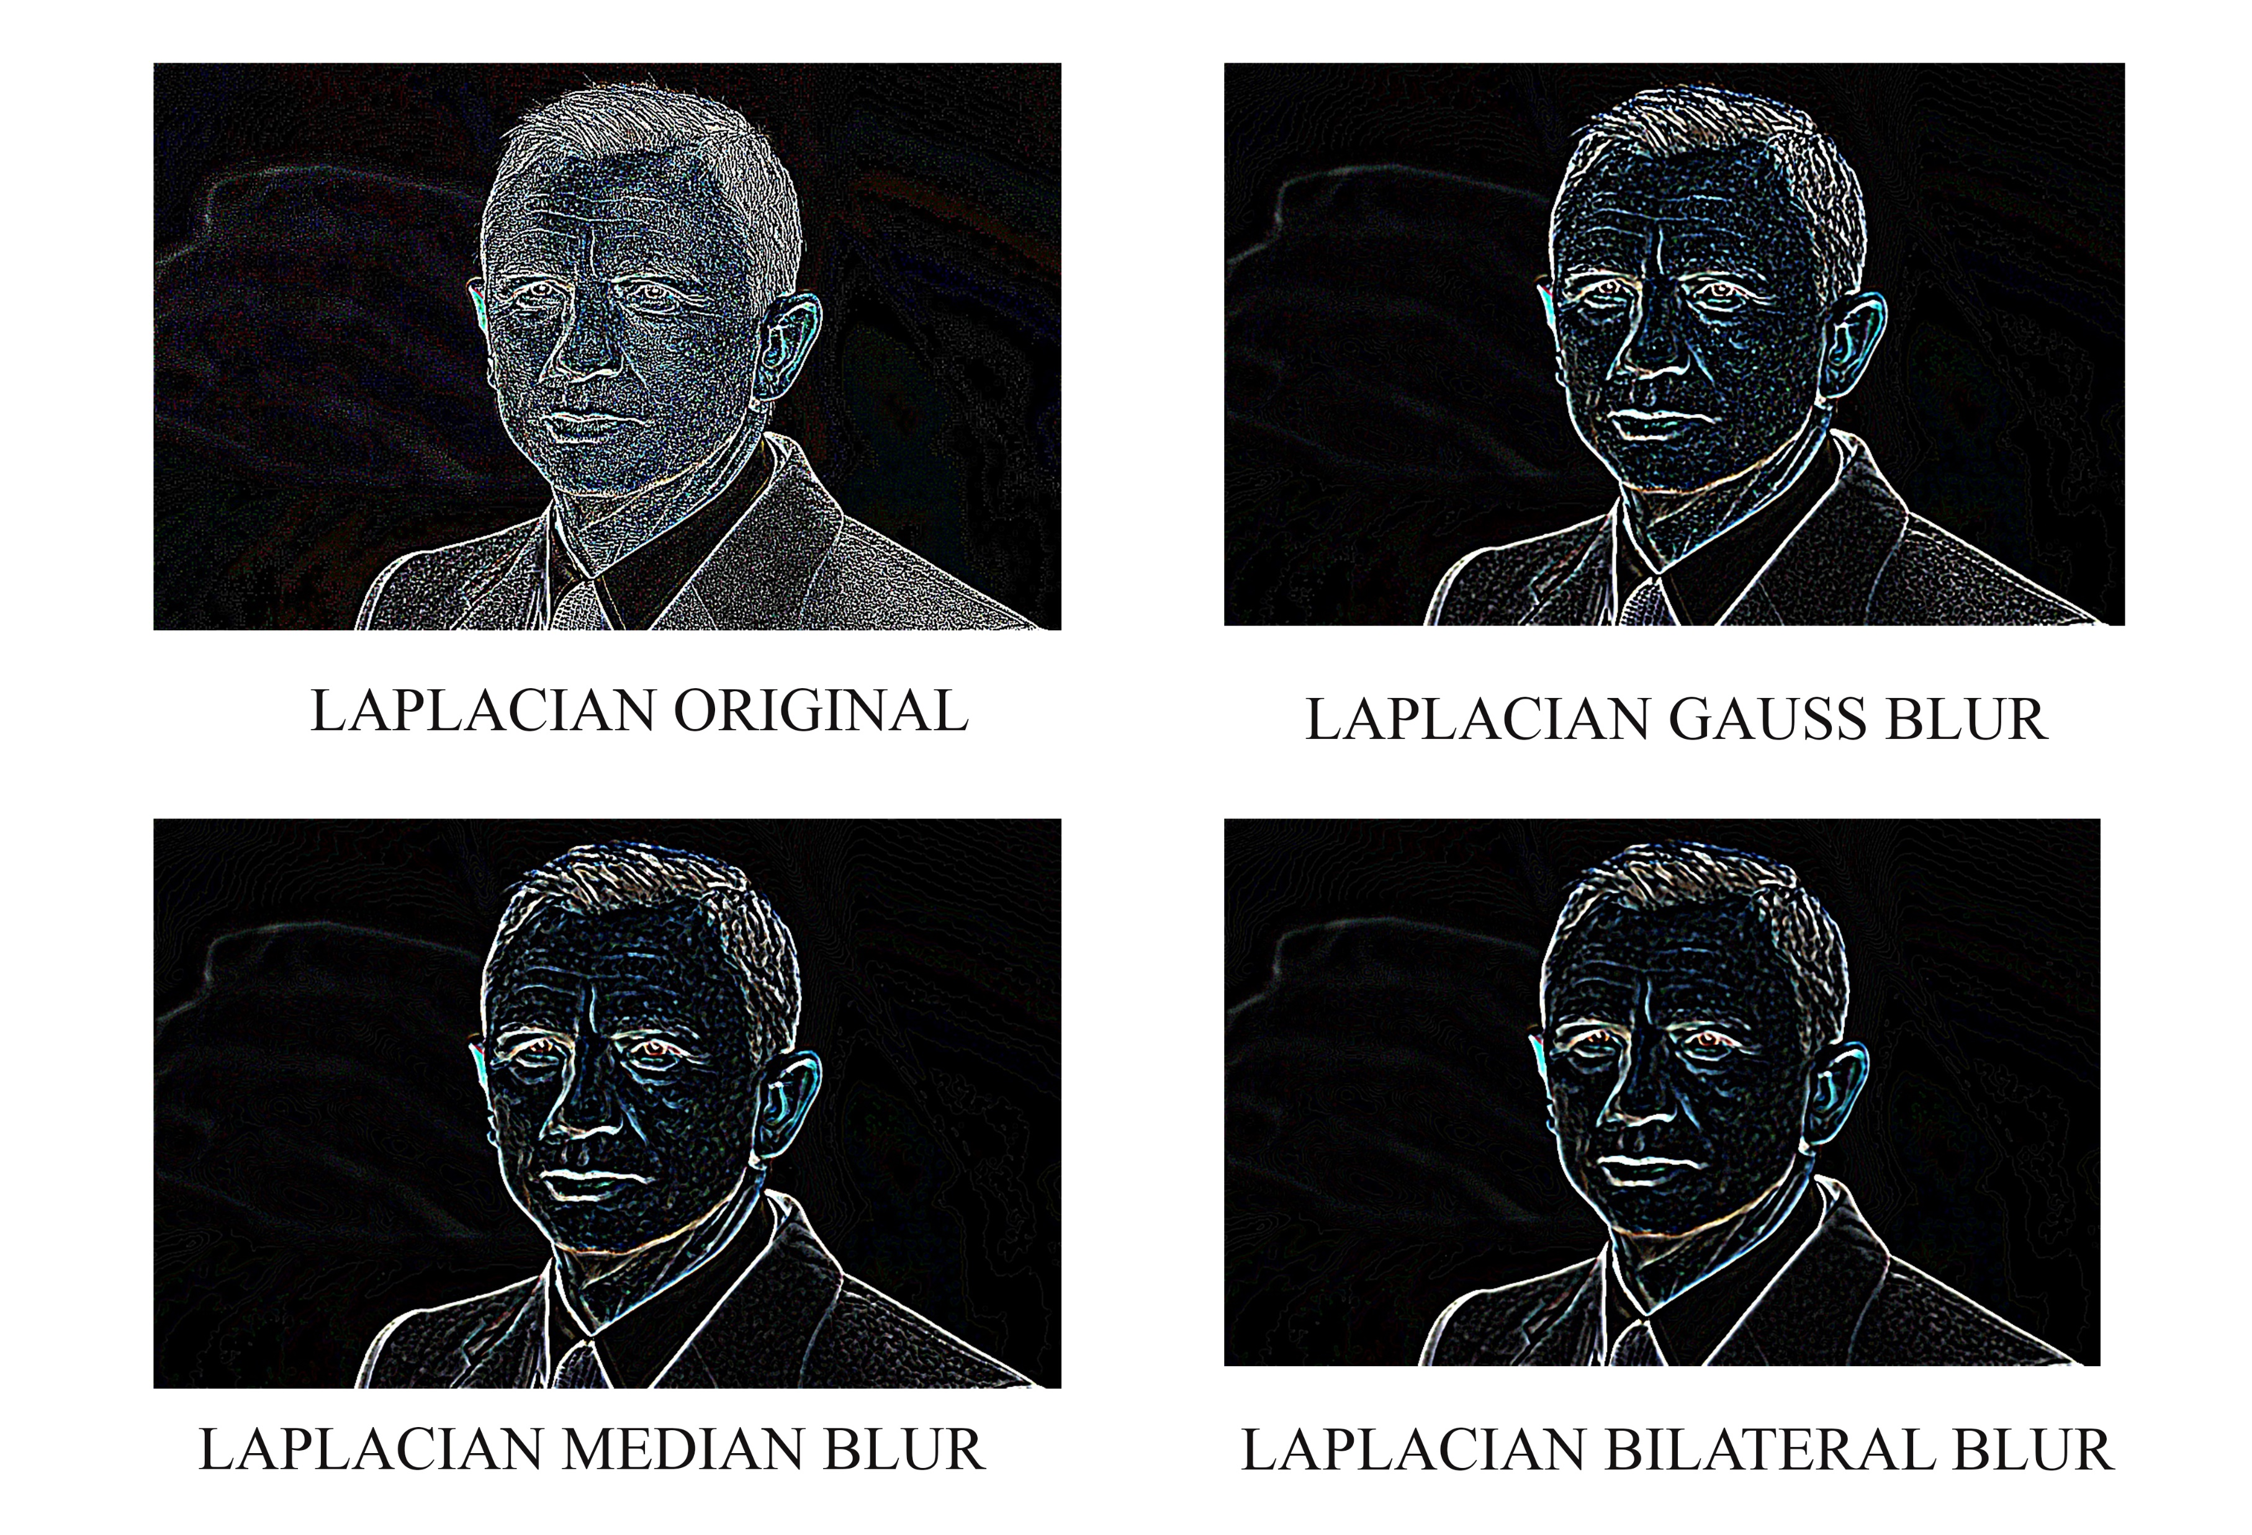
Application of Laplacian

Slide 8
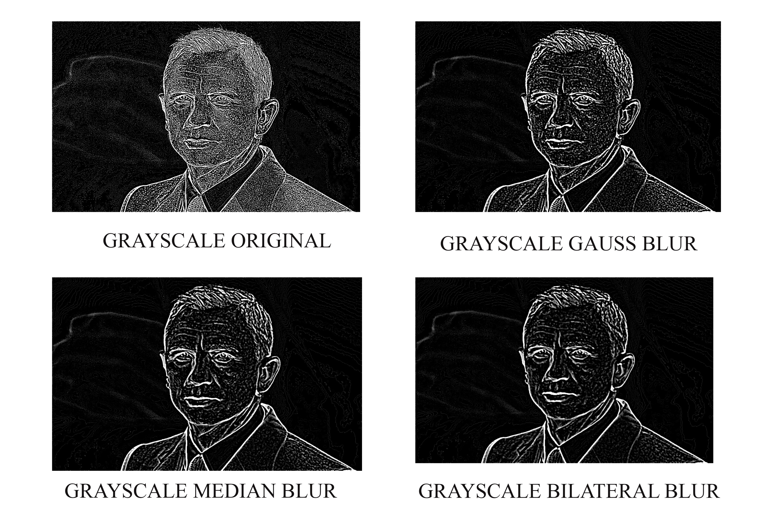
Application of grayscale

Slide 9
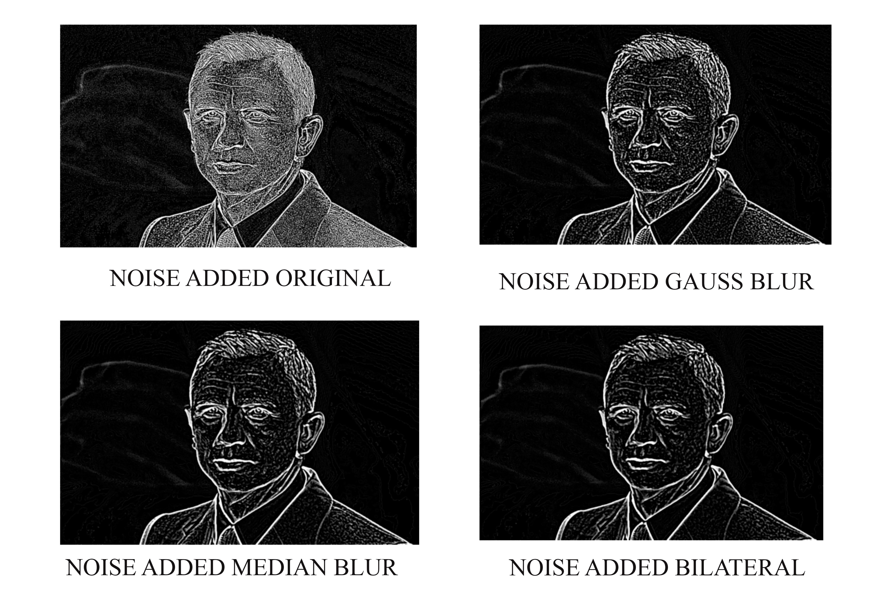
Application of noise

Slide 10
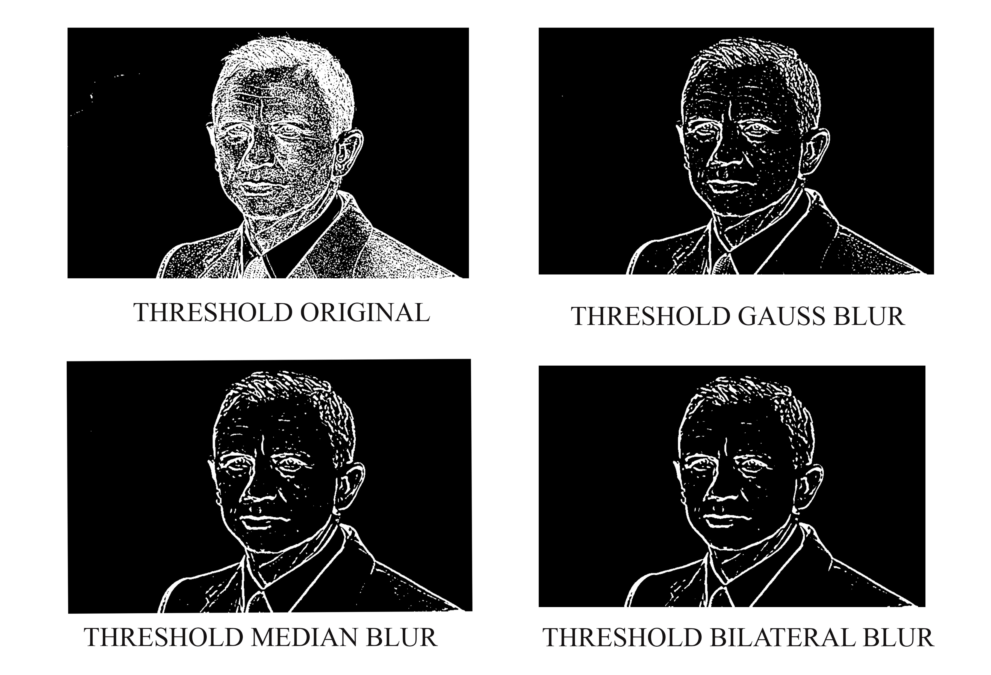
Application of threshold

Slide 11
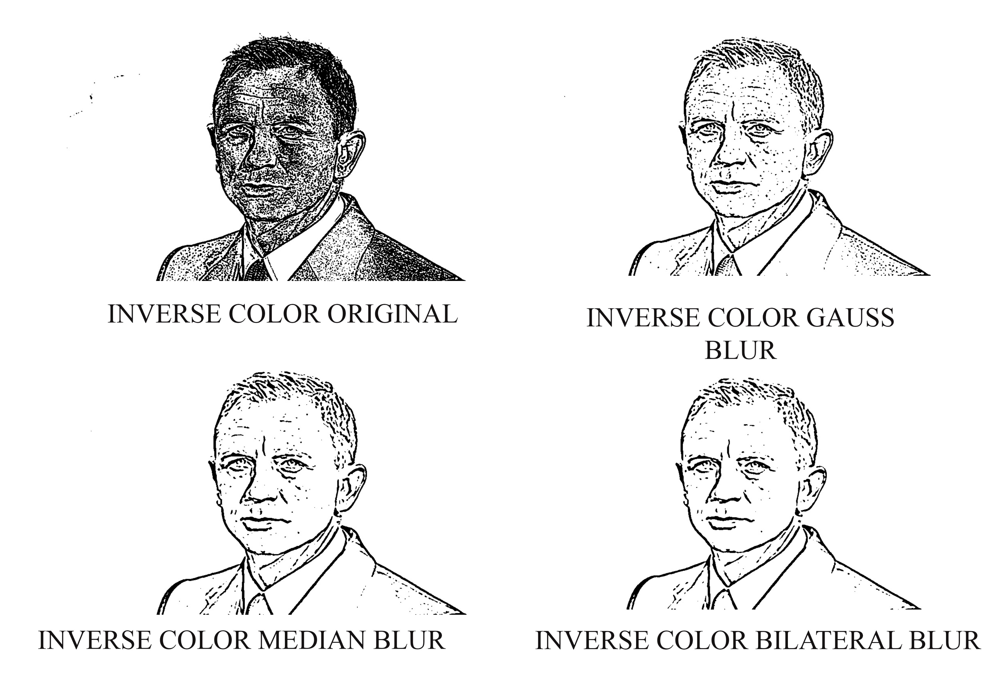
Inversing color

Slide 12
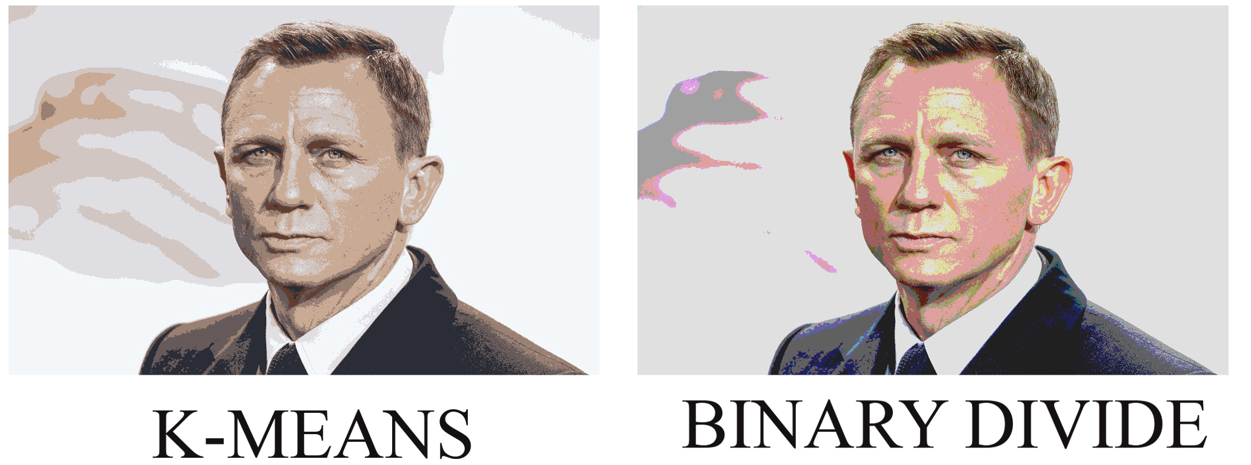
Reducing color of original – kmeans or binary divide

Slide 13
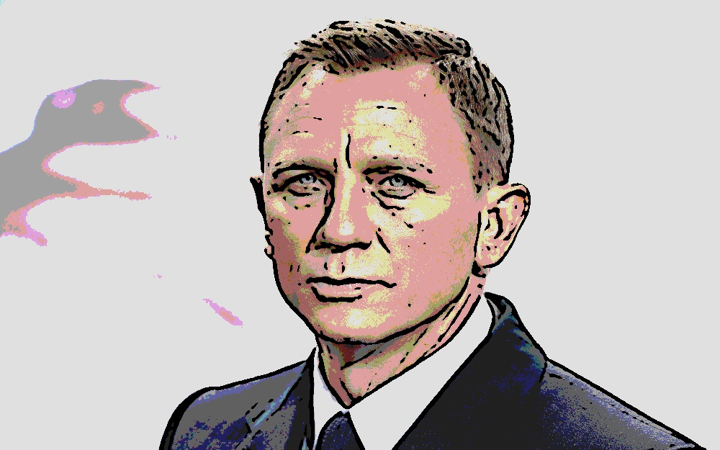
Output image

Slide 14
conclusion
All things considered, the Tonify algorithm is a success. It is capable of producing exactly the effect specified above, and a wide range of input images will yield satisfactory results. However, the algorithm is not perfect, and it does not respond predictably across all inputs. Given the variety of input images, it would be unrealistic to expect a one-size-fits-all approach to produce consistent results. In the future, an adaptive algorithm would probably be better suited to providing a consistent effect. Such an algorithm would recognize image types (portrait, indoor scene, outdoor scene for instance) and then change the edge detection parameters to better suit that particular image. Additionally, the algorithm may rely on an image derived from the hue, rather than the luminance, for edge detection. This might aid the algorithm in drawing contours around regions of different colours. Currently, the algorithm seems best suited for images that have a few large regions, each with relatively low colour diversity. Typically, the images that fail are those with a high amount of local colour variation and detail.

